Slide 1

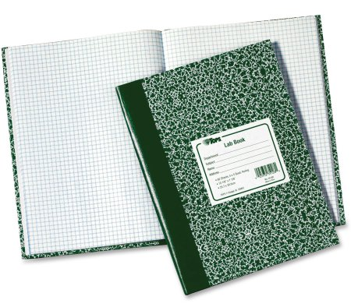



Stay engaged. Take notes as you watch videos.

Slide 2
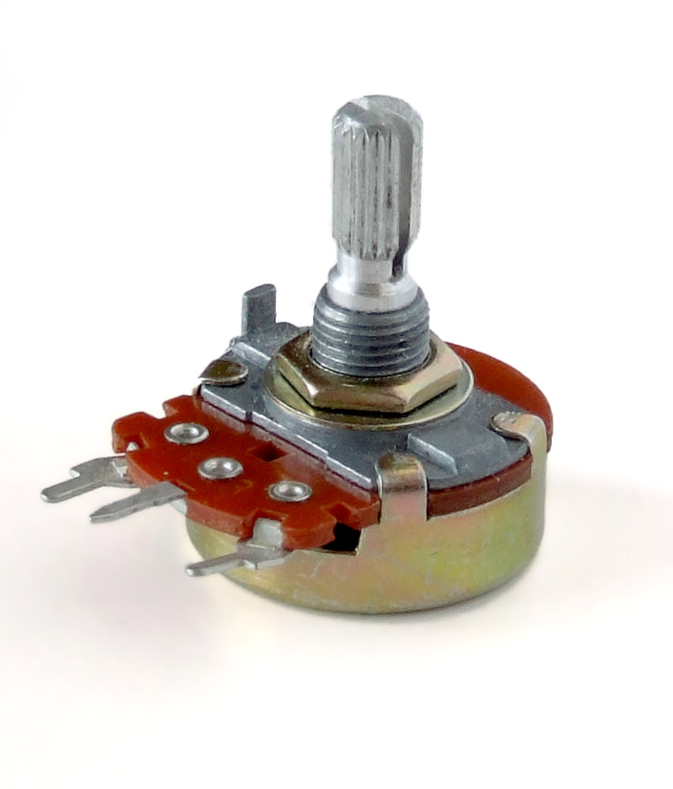
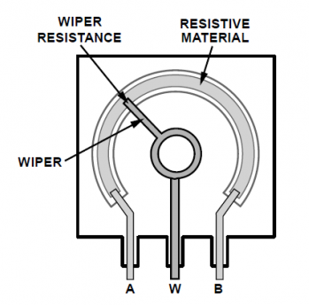
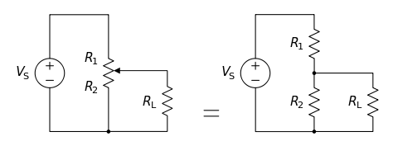
Potentiometers
Potentiometers convert angle into a resistance.
Works like a voltage divider!

Slide 3
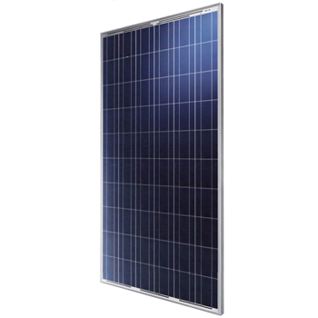
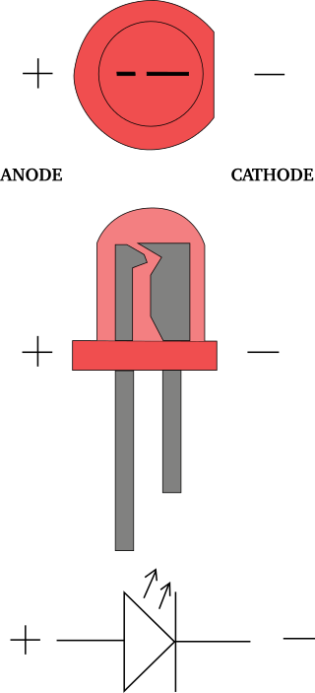
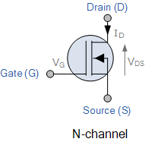
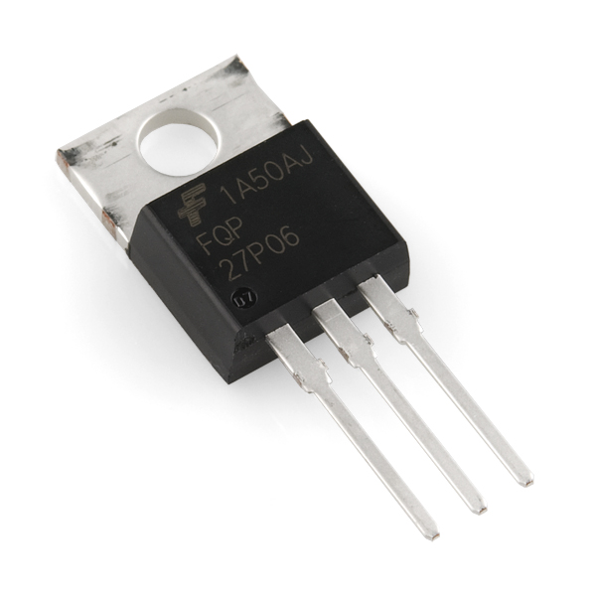
Semiconductor Devices
Solar Panels
Diodes and LEDs
Transistors

Slide 4
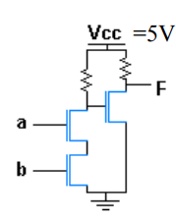
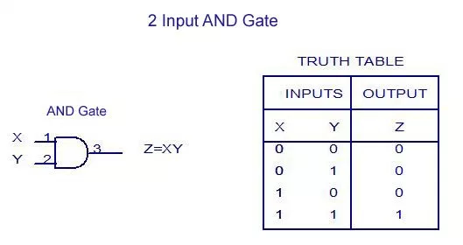
Logic Circuits
AND gate
Z
X
Y

Slide 5
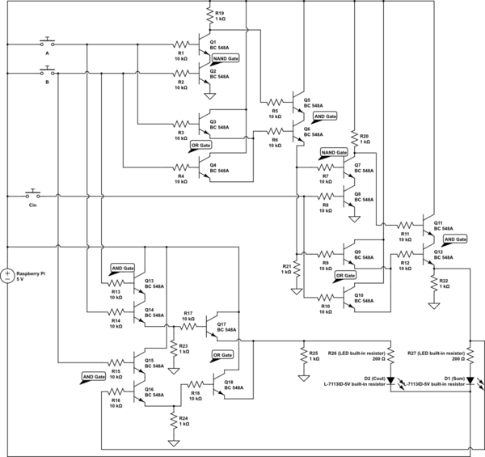
Logic Circuits – 2 bit adder

Slide 6
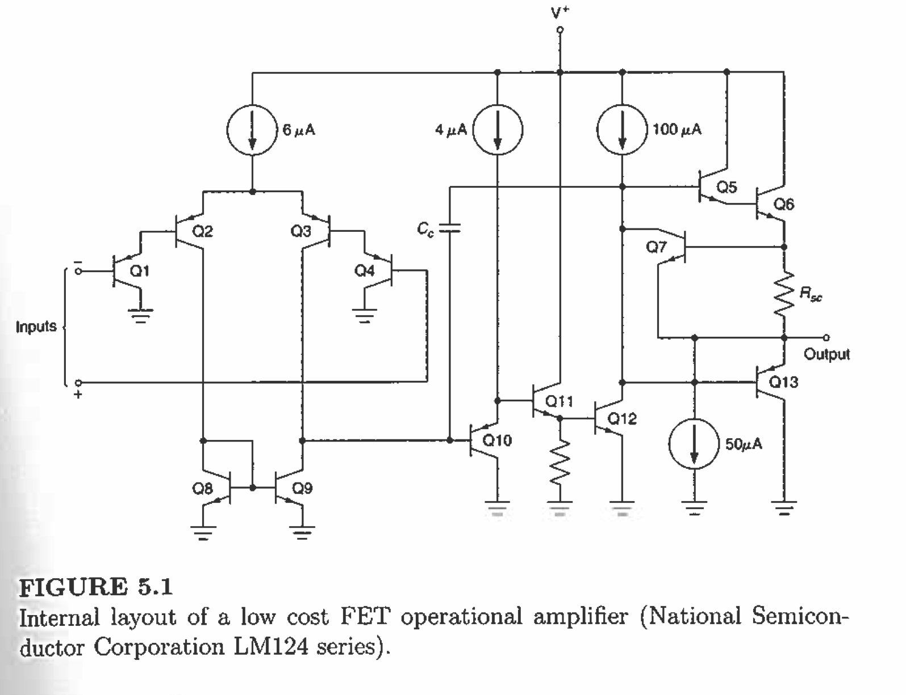
Amplifier Circuits

Slide 7
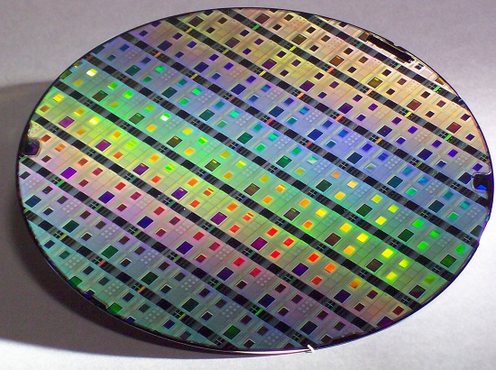
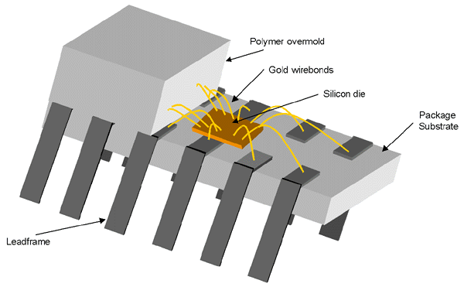
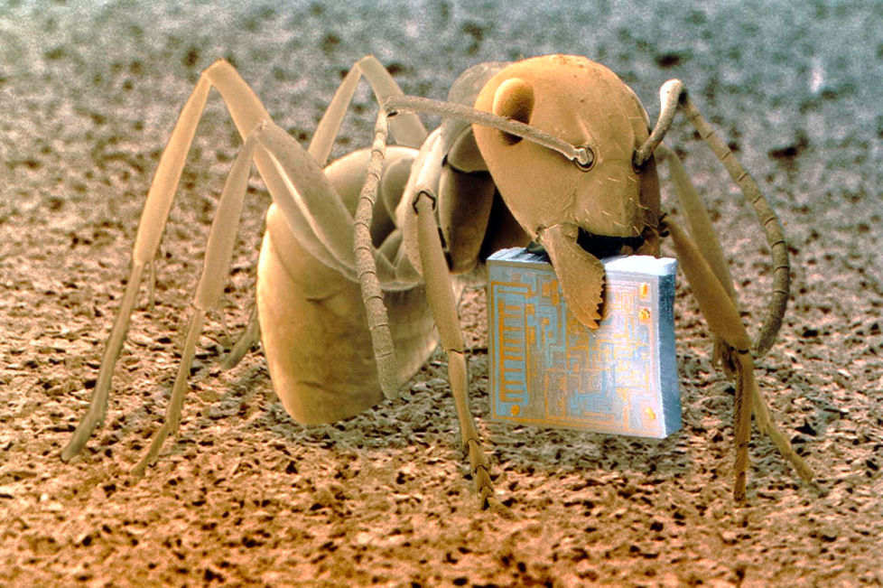
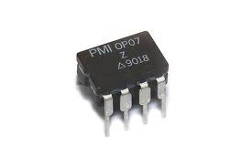
Integrated Circuits (I.C.s)
Wafers are diced up and packaged as IC chips.
DIP – “Dual inline package”

Slide 8
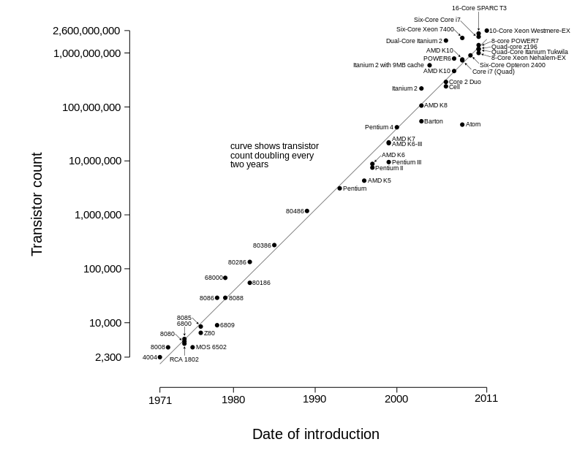
Moore’s Law
We can print over 1 billion transistors on a single chip!

Slide 9
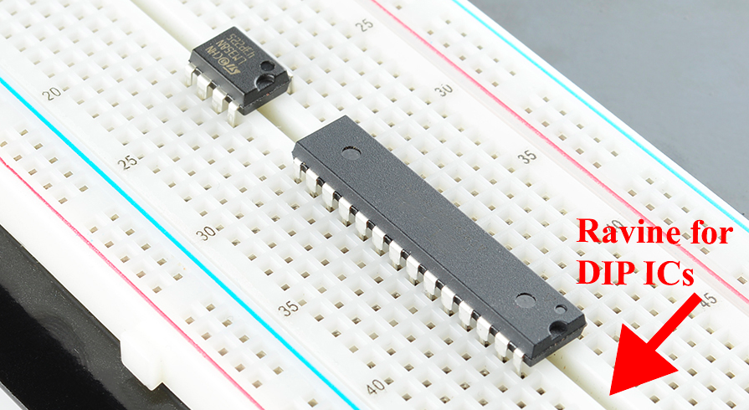
A8 – Electronics III
Silicon IC chips are encased in plastic.
Can be treated as a “Black Box”.

